Slide 1
Mrs. Trout
2021-2022
Room # 13
Grade 4

Slide 2
Mrs. Trout
Teaching 6 years @Biggs
Previously taught 2nd
2nd year in 4th
3 kids
2 Cats

Slide 3
Check Google Classroom, emails, and remind! Check their agenda.
School Phone: (909) 628-6497 ext. 7013
Email: lynda_trout@chino.k12.ca.us
Remind: send a text to 81010 with message@trout13

Slide 4
DRESS CODES
Monday: School Spirit Shirt
Wednesday: Briggs CLUB/SPORT Shirt
Friday: College/Military Shirt
*PLEASE REVIEW WITH YOUR CHILD*
HOMEWORK
Homework is due at 8:00 AM.
LATE projects will be marked lower.
ABSENCES
It is the student’s responsibility to get work
One day absence=one make-up day
PLEASE send a note if your child will be leaving early.

Slide 5
Class Schedule
8:00-8:30 Morning work - Computers
8:30- ELA
10:15-Recess
10:30-Math
12:00-Lunch
12:40-Social Studies
1:50-Science
3:00 Agendas/Clean-up
3:10 Dismissal
In addition to our daily schedule, our weekly schedule includes:
Music - Wednesdays 10:15-10:45
Library - Thursdays 9:00-9:30
PE - Tuesdays, Thursdays, Fridays
Art - Integrated into the curriculum

Slide 6
Be Respectful,
Be Responsible,
Be Safe
Follow Chain of Command…
Concerns or questions:
Students should communicate with the teacher.
Parent/Student/Teacher meeting
Parent/Student/Teacher/AP

Slide 7
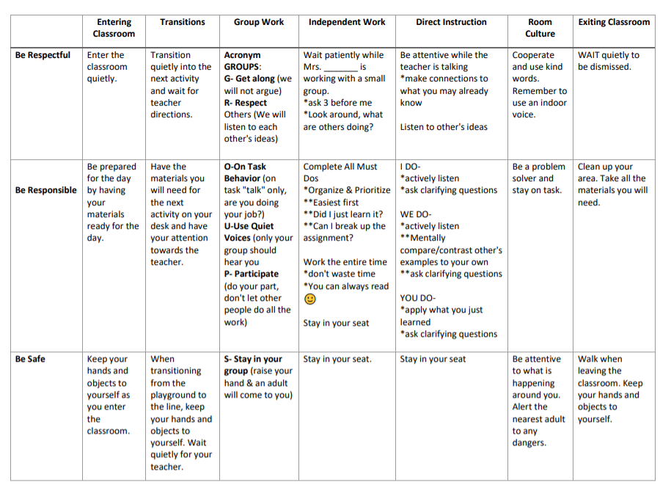
Classroom Expectations

Slide 8
21st Century Learning

Slide 10
NOVELS & SOCIAL STUDIES
California Native Americans & Missions
Gold Rush
Westward Expansion
Immigration

Slide 11
ConnectEd, AR, IXL, Reflex
ConnectEd - Weekly stories and resources can be found here. Make sure to log in first through classlink, then go to Google Classroom.
AR- Each student has their own personal goal for each trimester. . Students have the opportunity to take AR Tests every morning. Notification will be given if your child falls behind.
IXL-Review skills introduced in class. Needs to be accessed through the Briggs website.
Reflex -Math computer program - math facts

Slide 12
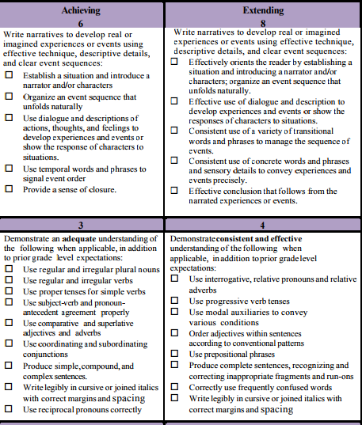
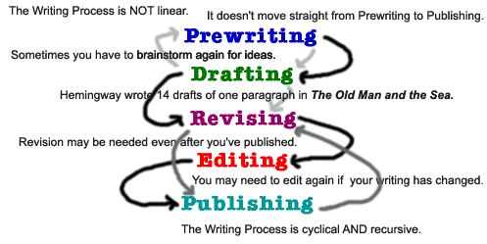
CCSS.ELA-LITERACY.W.4.1 - Write OPINION PIECES on topics or texts, supporting a point of view
CCSS.ELA-LITERACY.W.4.2 - Write INFORMATIVE/EXPLANATORY TEXTS to examine a topic
CCSS.ELA-LITERACY.W.4.3 - Write NARRATIVES to develop events using effective technique, descriptive details, and clear event sequences.

Slide 13
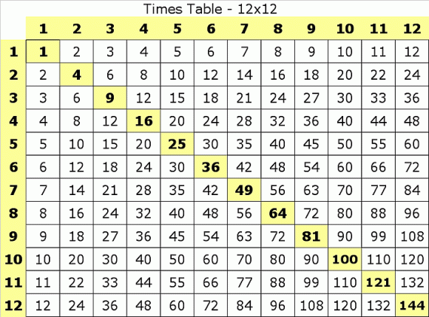
SHOW YOUR WORK

Slide 14
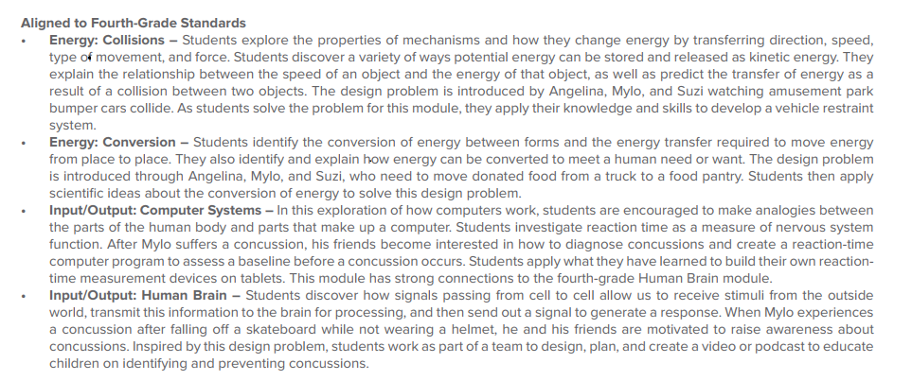

Slide 15
PICTURE PERSON
Classroom Lead
1. Volunteer 1
2. Volunteer 2
Parties
Parents will be assigned 1 party to bring items/attend/donate money.

Slide 16
Tuesday ~ Sport (35 min.)
Thursday ~ Mile Run (35 min.)
Friday ~ Sport (35 min.)
*GETTING READY FOR THE 5TH GRADE
PHYSICAL FITNESS TEST

Slide 17
MUSIC & RECORDERS
Wednesdays - 30 min.
Recorder/Book combo
will be provided

Slide 18
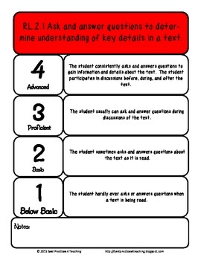
Standards-Based Report Card
EXCELS THE STANDARDS
*Standards-Based ~
Rubric Scores
MEETS STANDARDS
APPROACHING STANDARDS
BELOW STANDARDS

Slide 19
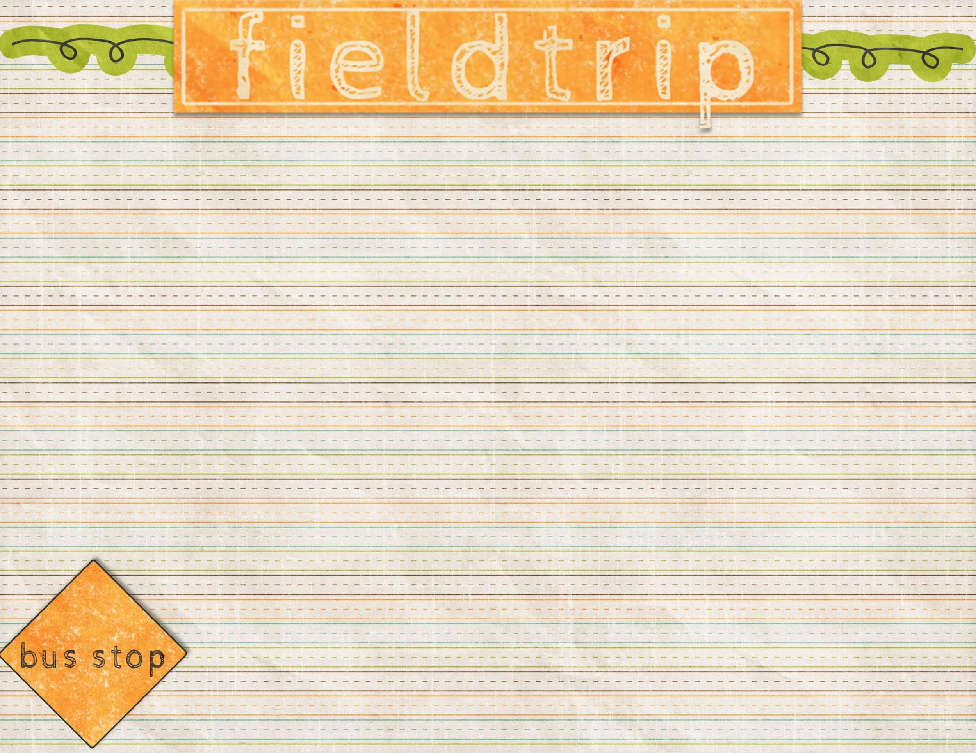
Date TBA
*3 chaperones
Date TBA
*3 chaperones

Slide 20
DAILY ESSENTIALS *Paper
*Pencils
*3 notebooks
*1comp. book
DONATIONS
*Tissues (Kleenex)
*Disinfecting wipes
*Baby Wipes
*Hand soap
*TBA-projects

Slide 21
Parent Volunteers welcome for Picture Person and PFA.
*Volunteers must be scheduled with teacher
*Must have proof of vaccination status or negative test within a week of activity.
*Must check in with office.

Slide 22
ODDS & ENDS
Agenda - $10
Spirit Wear - coming soon!
PFA Membership - $10 per family
Hundred Mile Club - $10
Blue Briggs Folders (Homework)
Graded papers (Keep)
Agenda - Includes daily homework
Signature needed when it includes notes from
teacher.

